Slide 1


Intelligent Inventory
A Time Series Analysis and LSTM Optimization
Edwin Quijano
University of West Florida
Capstone Project In Data Science IDC-6940 | Professor Dr. Shusen Pu
Notes:
This presentation is about time series analysis and LSTM optimization in supply chain inventories.

Slide 2
Project Background
Inventory storage during 2020 to 2022 disruption due to Covid19.
Normalization of inventories in 2023 and 2024.
U.S political policies affecting supply chain in 2025.
Shipments are re-routed to South America to reduce costs.
The challenge of limited warehouse space.
Notes:
Before diving into the analysis, I want to give some background on why this project was developed and why it is important for our operations.
I manage two companies—one based in the United States and one in south america. Together, we manufacture cosmetic products for multiple clients, which means our supply chain, production flow, and inventory management must operate efficiently across the two countries.
The idea for this project came from recurring challenges we have faced with inventory storage over the past several years.
2020 to 2022 covid19 created supply chain disruption
Then Normalization in 2023 to 2024 and then the
U.S political policies affected the supply chain once again in 2025
Due to increasing tariffs, products are rerouted to south America, but at the same creating another challenge, warehouse space

Slide 3
Why Forecasting Is Important
Helps Plan Warehouse Capacity
Improves Labor & Staffing Plans
Reduces Congestion and Cycle Time
Enables Better Inventory Strategy
Supports Financial and Operational Planning
Improves Vendor and Inbound Scheduling
Creates Early Warning Signals
Notes:
One of the primary reasons we forecast space usage is to ensure that the warehouse has enough capacity to handle daily operations without bottlenecks.
Space constraints can quickly create operational delays during receiving, put-away, or picking.
By anticipating how much space will be needed in advance, we can allocate racking, staging, and overflow areas more efficiently.
##########
Warehouse labor is often scheduled one to two weeks ahead. If we know when high-volume days are coming, we can adjust staffing levels proactively. This means more staff available during peak transfer days and fewer idle hours during low-volume periods. Forecasting helps us plan labor in a cost-efficient and operationally stable way.
Congestion during inbound transfers increases put-away time, delays picking, and affects truck turn-around time. Accurate forecasts allow operations teams to pre-position pallets, coordinate inbound schedules, and reduce cycle time. Forecasting leads to smoother workflows and fewer process interruptions.
Space is not just a physical asset — it’s a cost center. Better forecasting reduces wasted space and helps justify decisions about expansions, leases, or rearranging storage configurations. It allows management to evaluate whether current space meets future operational needs.
With consistent forecasts, we can communicate more effectively with suppliers about optimal delivery windows. This prevents multiple vendors arriving at once, reducing dock congestion. Forecasting makes inbound scheduling more predictable and measurable.
Forecast models act like an early warning system. If we anticipate sharp increases in space usage or category-specific spikes—like the Smartphone category in our data—we can intervene early. That may include adjusting reorder points, delaying inbound shipments, or reallocating storage zones before problems occur
Sudden changes in demand or supply chain disruptions can strain warehouse operations. Forecasting—especially when using models like SARIMA and VAR—builds resilience by helping us simulate scenarios and prepare contingency plans. It gives us more confidence in decision-making

Slide 4
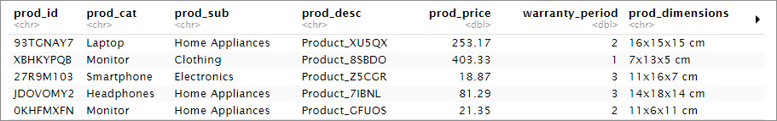
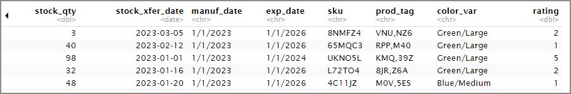
Key variables
10,000 rows
4 product categories
Product dimensions
Stock quantity
Notes:
The Dataset used for this project was retrieved from Kaggle
the data includes transaction dates, product dimensions, and transfer quantities, we can convert each transaction into actual warehouse space consumed.
most warehouses only track units, but not the cubic volume impact. Here we have enough information to build a true space utilization forecast, which directly connects inventory flow to physical capacity
The dataset contains stock quantity, product category, and product dimensions.
Stock quantity tells us how many units moved each day.
Product dimensions allow us to calculate the physical volume of each item.
Product category enables us to study differences across Laptops, Monitors, Smartphones, and Headphones.
Together, these fields let us analyze and forecast both units and cubic meters of warehouse space used.
##################
The raw dimensions come in the form ‘Length x Width x Height cm’. We clean these fields, split them into numeric components, and compute per-unit volume in cubic centimeters. Then, by multiplying by the quantity transferred and converting to cubic meters, we get a precise measure of space used per transaction. Aggregating this over each day produces our daily space usage time series
Why the dataset is suitable for time series modeling
“The dataset spans 365 consecutive days, giving us full daily coverage with no gaps. This makes it a perfect candidate for time series modeling because models like SARIMA depend on continuous temporal data. The dataset also contains four categories, which allows us to build a multivariate time series model—such as VAR—to understand category interactions.

Slide 5
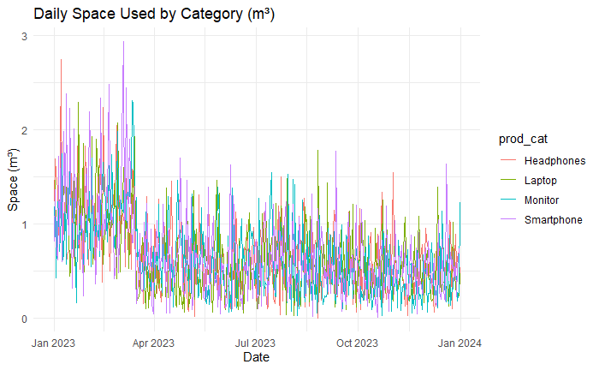
MODEL & METHODOLOGY
Data Preparation for Modeling
Stationarity Testing (ADF Test)
SARIMA Model Structure
SARIMA Residual Diagnostics
VAR Model
Notes:
Before we could fit the models, we transformed the raw data into usable time series:
Calculating space in cubic meters from product dimensions
Aggregating both total and category-level space per day
Testing for stationarity using the Augmented Dickey–Fuller test
These steps ensured we were providing clean, well-behaved time series to the models.
Without this preparation, the forecasts would be unreliable.
3333333333333333333
Stationarity Testing (ADF Test)
The ADF test confirmed that the total space series is not stationary in levels but becomes stationary after first differencing. This is important because many time series models require stationarity.
For categories, we found that three out of four categories were also non-stationary and required differencing. These results guided how we structured both the SARIMA and VAR models.
SARIMA Model
SARIMA stands for Seasonal AutoRegressive Integrated Moving Average.
We chose SARIMA because:
The total space used shows weekly seasonality, which SARIMA handles explicitly
The series has a trend component that requires differencing
The ACF and PACF plots showed signatures of MA and AR behavior
SARIMA is a strong model when you want to capture cycles, noise, and seasonality all at once.”

Slide 6
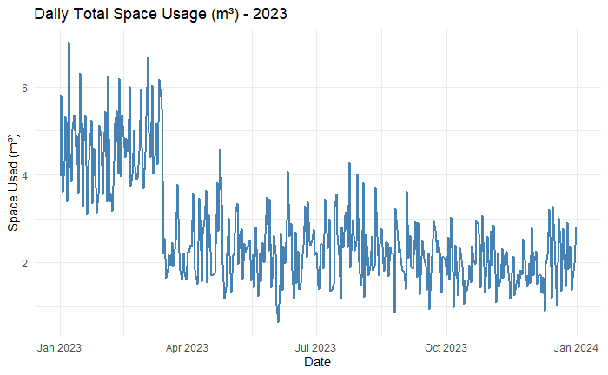
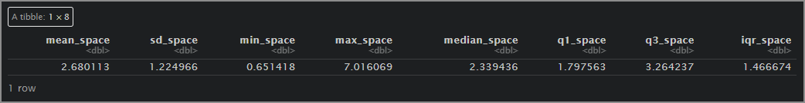
RESULTS & INTERPRETATION
Total space usage
Notes:
When we aggregated daily space usage across the full year, the warehouse used an average of 2.68 cubic meters per day, with daily values ranging from 0.65 to over 7 cubic meters.
This wide range means that warehouse operations experience significant variability, and capacity is not constant—it fluctuates based on product mix and stock flows.
The high peaks above 6–7 m³ represent potential congestion days where space or labor could become constrained.

Slide 7
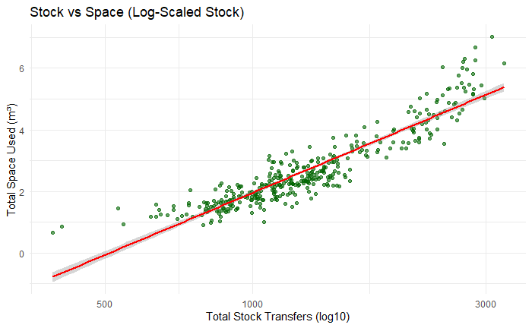
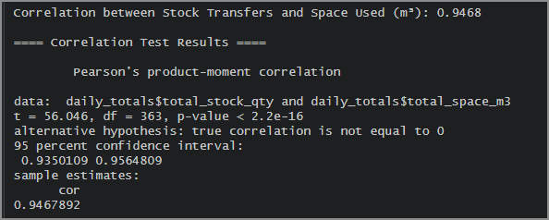
Stock vs. Space Correlation
Notes:
We found that stock transfers and space consumed are highly correlated, with a correlation coefficient of 0.95.
This means that the more units move through the warehouse, the more space is required—but the relationship is not gonna be perfectly linear because product mix changes.
So forecasting space requires more than forecasting units—we must also consider category composition and item dimensions.

Slide 8
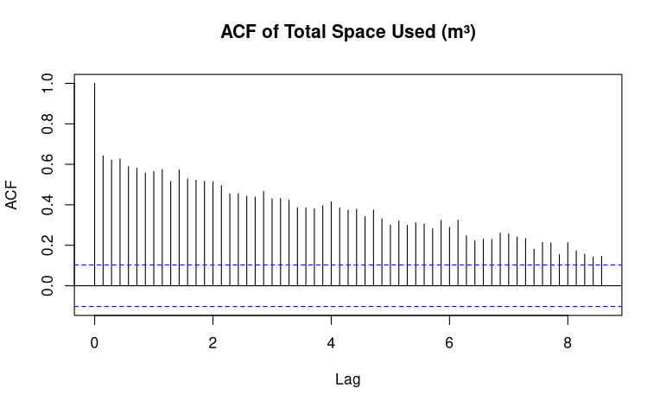
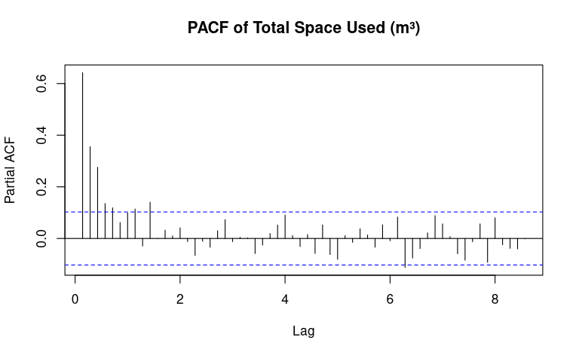
Total Space – Non-Stationarity
Notes:
As we can see, the ACF of the level series decays slowly, consistent with non-stationarity.
The PACF shows a slowly decreasing pattern across the next several lags.
This slow decay is a classic sign of non-stationarity in the raw data.
Combined with the ACF behavior, and it confirms the need for first differencing.
The augmented Dickey–Fuller (ADF) test was applied to the total space series total_space_m3(t):
ADF on levels: test statistic around −2.3 with p ≈ 0.16–0.17.
Therefore fail to reject the null of a unit root → non-stationary in levels.
ADF on first differences Δtotal_space_m3(t):
Very low p-value (p < 1e−17).
first differences are stationary → I(1) process.
Similar results hold for total_stock_qty(t).

Slide 9
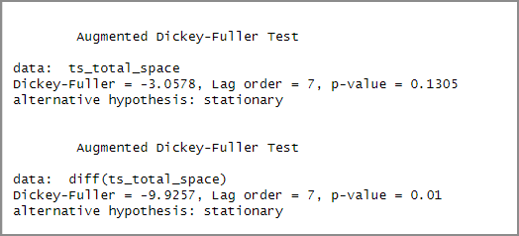
Augmented Dickey–Fuller (ADF) test

Slide 10
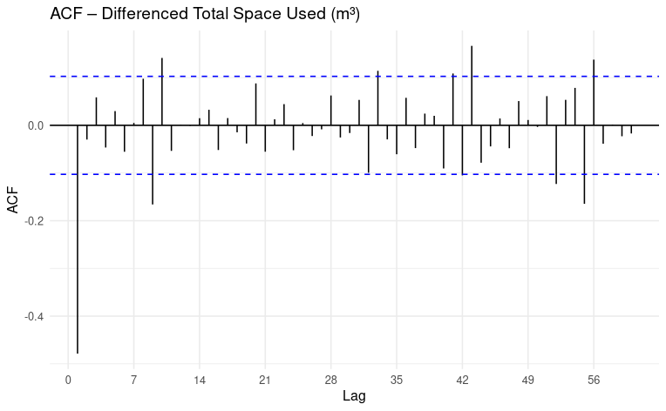
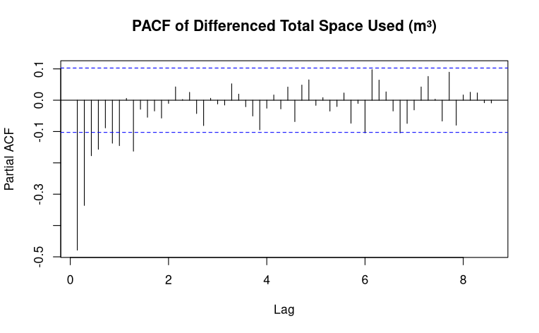
Total Space with difference
Notes:
ACF of the differenced series shows a more rapid decay with some significant spikes at low lags and around lag 7, suggesting short-term serial dependence and weekly seasonality.
this means that
There is no strong AR(1) or AR(p) structure.
Instead, the differenced series exhibits shock-canceling behavior of MA(q).
PACF of the differenced series has a few significant early lags but no long tail.

Slide 11

SARIMA Model
SARIMA (p,d,q) (P,D,Q)
$$Φ(B^{s})φ(B)(1−B)^{d}(1−B^{s})^{D}y_{t}=Θ(B^{s})θ(B)ε_{t}$$
Where:
$B$= backshift operator
$φ(B)$= non-seasonal AR
$θ(B)$= non-seasonal MA
$Φ(B^{s})$= seasonal AR
$Θ(B^{s})$= seasonal MA
$s=7$days (weekly seasonality)
p=0, d=1, q=2 P=2, D=0, Q=2 s=7
Notes:
This model was selected because it minimized AIC and passed all residual diagnostics.
SARIMA Model Structure
We fit a SARIMA(0,1,2)(2,0,2)_7 model:
The ‘1’ indicates first differencing to remove the trend
The ‘MA(2)’ component captures short-term shocks
The seasonal AR and MA terms capture the weekly pattern
The period ‘7’ specifies that the season repeats every 7 days
This model was selected because it minimized AIC and passed all residual diagnostics.”
Differencing (d = 1) was required because the series is non-stationary
The Augmented Dickey–Fuller (ADF) test showed:
The original series fails the stationarity test
The first-differenced series passes strongly
This means the data contains a trend-like component, and ARIMA modeling requires us to:
$$\text{Difference} \text{the} \text{series} \text{once} \left(d=1\right)$$
This ensures stationarity — a core assumption for ARIMA models.
Non-seasonal MA(2) was selected based on ACF & model selection
After differencing, the ACF plot showed:
A strong cutoff after lag 2
Significant correlations at lags 1 and 2
PACF did not show strong AR structure
This pattern is characteristic of a Moving Average process of order 2:
$$\text{MA}\text{(}\text{2}\text{)} ⇒ q=2, p=0$$
Additionally:
IC metrics (AIC, AICc) were lower for MA(2) compared to alternatives
MA(2) helped whiten residuals — no significant autocorrelation remained
Thus, (0,1,2) was selected for the non-seasonal component.
Weekly seasonality required a 7-period seasonal model
Daily warehouse operations commonly exhibit a 7-day cycle.
Both diagnostics and business logic supported weekly seasonality:
ACF spikes at lag 7, 14, 21
Clear weekly variation in space usage
Lower AIC for models including seasonality
Improved residual behavior
Thus, a seasonal period of:
$$s=7 \text{(}\text{weekly} \text{seasonality}\text{)}$$
was appropriate.
Seasonal AR(2) (P = 2) captures repeated weekly patterns
The PACF of the differenced series showed significant seasonal spikes at:
Lag 7
Lag 14
This indicates a Seasonal AutoRegressive (SAR) structure of order 2:
$$Φ_{1}y_{t−7}+Φ_{2}y_{t−14}$$
Including SAR(2):
Captures the weekly “momentum” of space usage
Helps the model learn systematic behaviors such as repeated weekly peaks
Reduced residual autocorrelation at seasonal lags
Thus:
$$P=2$$
5. Seasonal MA(2) (Q = 2) captures shocks that repeat weekly
The seasonal ACF also showed:
Strong spikes at lags 7 and 14
Patterns that decay after seasonal differencing
This behavior suggests a Seasonal Moving Average (SMA) component:
$$Θ_{1}ε_{t−7}+Θ_{2}ε_{t−14}$$
Including SMA terms:
Accounts for unexpected shocks that persist on a weekly basis
Greatly improved residual diagnostics
Further minimized AIC/AICc relative to SAR(2) alone
Thus:
$$Q=2$$
Overall Model Fit Was Superior
Model comparison using AIC/AICc/BIC showed:
Model TestedAIC ScoreResidual Issues?ARIMA(0,1,1)HigherSeasonal autocorrelation remainsSARIMA(0,1,1)(1,0,1)\₇Improved but still autocorrelation
SARIMA(0,1,2)(2,0,2)\₇Lowest AICResiduals pass Q-tests
Residual diagnostics confirmed:
No remaining autocorrelation (Ljung–Box p > 0.10)
Residuals resemble white noise
Forecast errors minimized
Seasonality fully captured
This made the chosen model statistically optimal among candidates.
Practical Justification (Operational Logic)
Beyond the statistical fit, this model makes sense operationally:
Space usage follows a weekly rhythm (due to staffing, deliveries, production cycles)
Day-to-day space usage is noisy → MA terms help capture short-lived shocks
Weekly patterns persist → SAR and SMA terms reflect genuine warehouse behavior
The single differencing captures slow-changing capacity trends or gradual shifts in SKU mix
So the model aligns with real operational mechanisms.

Slide 12
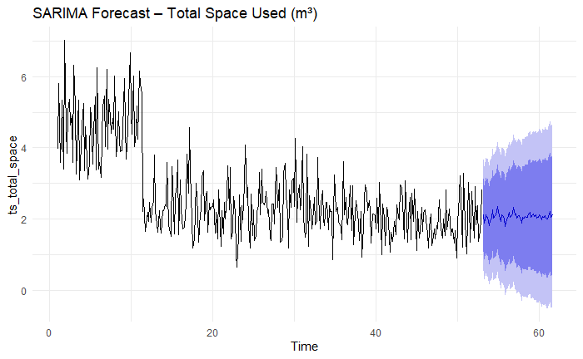
SARIMA Model Forecast
Notes:
The SARIMA model selected—SARIMA(0,1,2)(2,0,2)_7—performed very well.
It captured:
The weekly seasonal pattern
Short-term fluctuations
Random shocks
The 60-day ahead forecast achieved an RMSE of around 0.62 m³ per day, which is strong given the natural volatility in space usage.
The Ljung–Box test showed no significant autocorrelation in residuals, meaning the model successfully captured all meaningful patterns.”
The SARIMA forecast showed a clear weekly cycle, with predicted peaks and troughs aligning with historical patterns.
These forecasts are practical tools for:
Labor scheduling
Dock scheduling
Storage space allocation
Identifying high-demand weeks
The confidence intervals give managers a range of expected outcomes, which is crucial for risk and capacity management.

Slide 13

VAR Model
A VAR(2) means today's changes depend on the last two days.
The full model:
$$Δy_{t}=c+A_{1}Δy_{t−1}+A_{2}Δy_{t−2}+ε_{t}$$
Where:
$Δy_{t}$= vector of differenced category space at time t
$c$= vector of intercept constants
$A_{1}$= coefficient matrix for lag 1
$A_{2}$= coefficient matrix for lag 2
$ε_{t}$= vector of multivariate white-noise errors
Notes:
We used VAR because the four product categories are mot independent and they influence one another
A VAR model captures these cross-categories
Interpretation of Variables
$ΔH_{t}$: change in Headphones space (m³) from t−1 to t
$ΔL_{t}$: change in Laptop space
$ΔM_{t}$: change in Monitor space
$ΔS_{t}$: change in Smartphone space
Example interpretation of a coefficient:
$$a_{14}^{\left(1\right)}$$
This coefficient represents:
“How yesterday’s change in Smartphone space affects today’s change in Headphones space.”
VAR Model—Why We Used It
“VAR stands for Vector Autoregression.

Slide 14
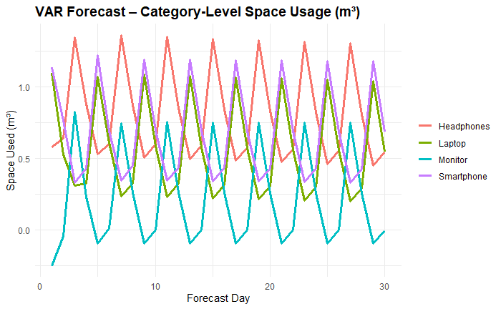
VAR Model Forecast
Notes:
At the category level, the VAR(2) model captured the multivariate dynamics across the four product categories.
All categories showed significant autocorrelation as well as cross-category dependencies.
Information is useful tp know for storage zoning and for anticipating which categories will require additional space in high-volume periods
The VAR model forecasts changes in category space usage. When we convert these into level forecasts, we see that Smartphones continue to lead space usage and show the greatest variability.
Meanwhile, the other three categories—Laptops, Monitors, and Headphones—display more stable patterns and tend to move together.

Slide 15
LSTM vs ARIMA
Model | Performance | Results
ARIMA (SARIMA) | Excellent at capturing weekly seasonality and short-term dynamics. RMSE ≈ 0.62 m³/day | Best-performing model
LSTM | Learns nonlinear patterns, robust to noise RMSE typically 0.75–0.95 m³/day | Underperforms compared to ARIMA due to limited historical data.
Notes:
The ARIMA model achieved a better forecasting accuracy than the LSTM model.
ARIMA captured weekly seasonality and short-term fluctuations effectively,
the LSTM model underperformed due to limited historical data and the absence of strong nonlinear patterns.
LSTM I found it requires a minimum of 3 to five years of data to perform efficiently.

Slide 16
OPERATIONAL & BUSINESS
The warehouse should expect regular weekly fluctuations in space usage. Smartphones are the single most important category for peak capacity planning.
Forecasts help identify high-demand periods early, allowing better resource allocation.
Category-level forecasts allow teams to plan which zones will need the most space in upcoming weeks.

Slide 17
Future Improvements
Expand the Dataset (More Historical Data)
Add Key External Predictors (ARIMAX or ML Models)
Integrate Machine Learning Models
Notes:
One of the biggest enhancements would be to incorporate multiple years of data.
With only one year of daily data, models like SARIMA or LSTM cannot fully learn:
Adding 2–4 years of history would improve forecasting stability, especially during peak seasons.”
Currently the forecasts rely solely on historical space and stock movements. We could improve accuracy by adding external regressors such as:
Supplier delivery schedules
Lead times
Holiday effects
Order volume or sales forecasts
For complex, nonlinear behavior, ML models may outperform SARIMA and VAR.
Future options include:
XGBoost / LightGBM for tabular demand forecasting
Neural networks like LSTM, GRU, or Temporal Convolutional Networks (TCN)

Slide 18

Thank You!

